Slide 1
Code Bridge
Leonardo Alvarez
BalvindeR Singh
COSC 6050 – Elements of Software Development
Phase 2 – Requirements, Design & Code
Instructor – Dr. Sheikh Iqbal AhameD
Date - 11/09/2026
Notes:
[0:15] Introduce yourselves and the one-line pitch: CodeBridge tells a developer, before they merge, which shared Maven dependencies two GitHub repositories disagree on and how risky each difference is. Phase 2 = requirements, design models and working, tested code.

Slide 2
Agenda
Problem & System Overview
Personas & User Stories
Software Requirements Specification
Scenario Models – Use Case Diagram & Narrative
Design Document – Architecture & Class Diagram
Behavior Models – Sequence & State Diagrams
Flow Models – Activity & Data Flow Diagrams
Enterprise Security & PostgreSQL
Acceptance Tests & Code Walkthrough
Live Demo, Conclusion & Next Steps
Notes:
[0:10] Don't read the list. Say: requirements, then models, then proof it works – tests, code and a live demo.

Slide 3
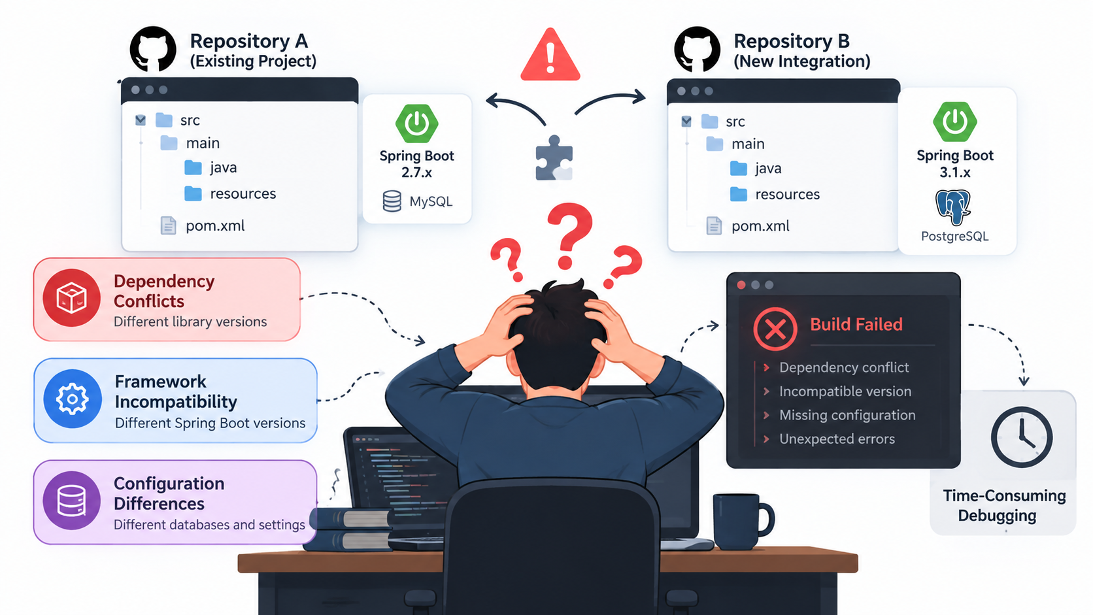
Problem Statement
Integrating external GitHub repositories into existing projects often leads to hidden compatibility conflicts, dependency issues, and unexpected failures. Developers face challenges in identifying potential integration risks, compatibility issues, and required code modifications, often resulting in unexpected errors and increased development time.
Notes:
[0:20] Tell it as a story: a developer pulls in an external module, the build passes, and a week later a transitive version clash breaks production. Teams find these late because nobody compares the two pom.xml files up front.

Slide 4
System Overview
CodeBridge is a web platform that checks two public GitHub repositories for integration risk before you merge them.
Phase 2 delivers a working slice: a React + MUI single-page app talks to a secured Spring Boot REST API that reads both root pom.xml files from GitHub, finds shared dependencies with different versions and ranks each one HIGH, MEDIUM or LOW.
Projects are stored in PostgreSQL through versioned Flyway migrations; every API call needs a login and a CSRF token. The RAG assistant and readiness report move to Phase 3.
Notes:
[0:15] Emphasise what changed since Phase 1: the vision is the same, but now there is a separate React frontend and Spring Boot backend, a real PostgreSQL schema and a security layer. AI features are scheduled for the next phase.

Slide 5
PERSONA OVERVIEW 1 |  | PERSONA OVERVIEW 2
        NAME – Romy
        AGE: 29
        OCCUPATION: Backend Java Software Developer
        GOAL: Romy would like to become more efficient in her role
        PAIN POINTS:
        Has to open each project by hand to find to setup a pom.xml file
        Loses time on repetitive setup work before any real integration can start
        Worries that a missed version mismatch will cause problems
        ACTIVITIES:
        Pastes the GitHub URLs for Project A and Project B into the web UI
        Reviews the extracted metadata for each repository
        Checks that both repositories were imported correctly
        NAME - Maya
        AGE: 42
        OCCUPATION: Software Developer / Integration Specialist
        GOAL: Maya would like to become more efficient in her role
        PAIN POINTS:
        Spends too much time manually checking compatibility issues
        Does not understand downstream impacts of a single integration issue
        Wants confidence that changes are safe before merging
        ACTIVITIES:
        Reviews compatibility reports before integrating third-party modules
        Investigates flagged findings in code, dependencies, and configuration
        Compares risk levels and impact chains to decide what to fix first
USER STORY
“As a software developer, I want to connect two GitHub repositories so that CodeBridge can analyze their compatibility for integration.”
USER STORY
“As a software developer, I want the system to compare Project A and Project B and identify potential compatibility conflicts so that I can understand what will break before integrating the external module”
ACCEPTANCE CRITERIA
    User can enter two GitHub repository URLs (public repos only) in the web UI
    System fetches repository metadata via GitHub REST API
    System detects and extracts Java version from pom.xml
    System detects Spring Boot version from pom.xml
ACCEPTANCE CRITERIA
    System compares Java versions and flags mismatches
    System compares Spring Boot versions and identifies API breaks
    System detects transitive dependency conflicts
    System identifies missing and outdated dependencies
DEFINITION OF DONE
    Meet the criteria to finish the user story
    The criteria often include development, testing, and documentation requirements
    Maven pom.xml parsing is implemented using Maven Resolver or custom parser
    PostgreSQL schema for PROJECT table is created and migrations are ready
DEFINITION OF DONE
    Compatibility detection engine is implemented with six sub-analyzers
    Rule base for compatibility scoring is documented and configurable
    PostgreSQL schema for COMPATIBILITY_FINDING table is created
    Unit tests cover each analyzer in isolation
PRIORITY
High
PRIORITY
Medium
Notes:
[0:15] Maya (integration specialist) cares about risk and what to fix first – that drives the severity ranking. Romy (backend Java developer) wants to skip manual pom.xml digging – that drives the paste-two-repos workflow.

Slide 6
User Stories
ID | User story | Status | Tests
US1 | As a developer, I want to enter two GitHub repositories and have them validated so that only safe, public repos are analysed. | Done | 18
US2 | As a developer, I want each repository's metadata (description, language, branch) so that I know what I am comparing. | Done | 11
US3 | As a developer, I want the system to read each root pom.xml securely so that dependencies are extracted without risk. | Done | 18
US4 | As an integration specialist, I want shared dependencies with different versions detected so that I see conflicts before merging. | Done | 24
US5 | As an integration specialist, I want each conflict ranked HIGH / MEDIUM / LOW so that I fix the riskiest first. | Done | 28
US6 | As a security-conscious team, I want every API call authenticated and CSRF-protected so that only trusted clients can run analyses. | Done | 10
US7 | As a team lead, I want comparison projects stored in PostgreSQL so that analyses are durable and auditable. | Done | 5
US8 | As a developer, I want a responsive side-by-side dashboard so that I can read the results at a glance. | Done | UAT
US9 | As a developer, I want Java and Spring Boot version mismatches flagged so that framework breaks are caught. | Planned | –
US10 | As a developer, I want a readiness report and an AI (RAG) assistant so that I know what to change. | Planned | –
Notes:
[0:30] Requirement 1 – all user stories. Seven are implemented and each maps to automated tests; two carry over from the Phase 1 vision. Point out the test column: every Done story has executable acceptance tests behind it.

Slide 7
Software Requirements Specification
Functional requirements
Non-functional requirements
FR1 Accept two repository identifiers; allow only https://github.com/owner/repo (US1)
FR2 Retrieve repository metadata from the GitHub REST API (US2)
FR3 Download and parse each root pom.xml, resolving ${properties} (US3)
FR4 Report shared groupId:artifactId pairs whose versions differ (US4)
FR5 Classify each conflict HIGH / MEDIUM / LOW / UNKNOWN with a summary (US5)
FR6 Require authentication and a valid CSRF token for API calls (US6)
FR7 Create, list and retrieve comparison projects in PostgreSQL (US7)
FR8 Show results side by side, filterable by severity (US8)
Security: Basic auth + CSRF; XXE disabled; URL allow-list; errors never leak internals
Performance: 5 s connect / 10 s read timeouts; pom.xml ≤ 512 KB; response ≤ 1 MB
Reliability: GitHub 404 / rate-limit / outage mapped to clear 404, 503, 502 messages
Maintainability: Layered Spring design, 114 automated tests, Flyway migrations, CI
Usability: Responsive Material Design UI, light/dark mode, inline validation
Portability: Separate frontend/backend; H2 dev profile and one-click run scripts
Constraints: Public repos only, root pom.xml only, GitHub limit ≈ 60 calls/hour
Notes:
[0:25] Requirement 2. Functional requirements are what the system does; non-functional are the qualities we can test – security, performance limits, reliability. Each FR traces to a user story ID.

Slide 8
Scenario-Based Model – Use Case Diagram
CodeBridge system
Enter repository pair
Validate GitHub URLs
Fetch & parse pom.xml
«include»
Developer
(Maya, Romy)
Compare repositories
Authenticate
(Basic + CSRF token)
«include»
«include»
GitHub
REST API
«include»
View side-by-side dashboard
Classify conflict severity
«extend»
Save comparison project
Filter by severity
Readiness report
(planned)
«extend»
PostgreSQL
Notes:
[0:30] Requirement 3 – design for 5-8 stories as a UML use case diagram. Primary actor: the developer (both personas). Secondary actors: GitHub and PostgreSQL. Compare Repositories <<include>>s validation, authentication, fetching and severity classification; filtering <<extend>>s the dashboard. The dashed use case is planned for Phase 3.

Slide 9
Scenario-Based Model – Use Case Narrative
UC-03 Compare repositories
Primary actor: Developer
Secondary: GitHub REST API
Stories: US1, US3, US4, US5, US6
Precondition: Backend running; developer authenticated; both repos public with a root pom.xml
Postcondition: Dashboard shows dependency counts, conflicts and a severity summary
Main flow
Alternate flows
1. Developer enters owner/repo A and B
2. UI validates format and requests a CSRF token
3. UI POSTs /api/maven/compare with the token
4. Security verifies login and token
5. API validates both URLs (HTTPS github.com only)
6. Service fetches and parses both pom.xml files
7. Service compares shared dependencies
8. Classifier ranks each conflict
9. UI renders cards, tiles and table
A1 (step 1/5)
Invalid or non-GitHub URL → inline error / 400, nothing fetched
A2 (step 4)
No login → 401; missing or wrong CSRF token → 403
A3 (step 6)
pom.xml missing → 404; rate limit → 503; GitHub down → 502
A4 (step 7)
No shared differing versions → “No version conflicts found”
Notes:
[0:20] The textual scenario behind the main use case. Walk the main flow quickly, then name the three alternate flows – each one is covered by an automated test.

Slide 10
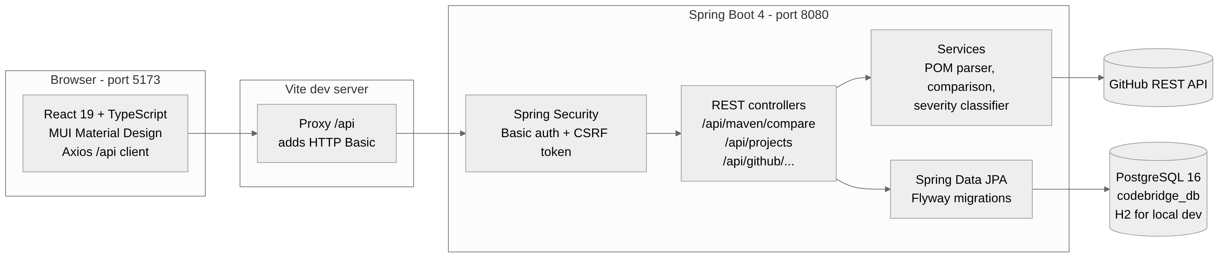
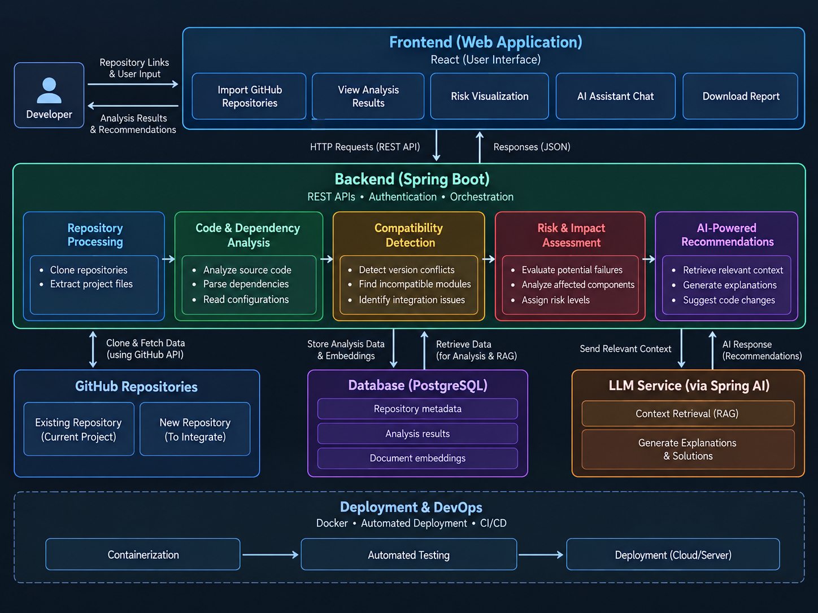
System Architecture
Frontend
Backend
Data & security
React 19 + TypeScript SPA, MUI (Material Design), Axios client. Runs separately on port 5173.
Spring Boot 4 REST API (Java 21): controllers, POM parser, comparison and severity services.
PostgreSQL via Spring Data JPA + Flyway; Spring Security with HTTP Basic + CSRF token.
Notes:
[0:30] Design document, part 1. Two independently runnable apps. The browser never holds credentials: the Vite proxy adds the Basic header in development. Everything below the security filter is plain Spring layers – controller, service, parser, repository – which is why each piece is unit-testable on its own.

Slide 11
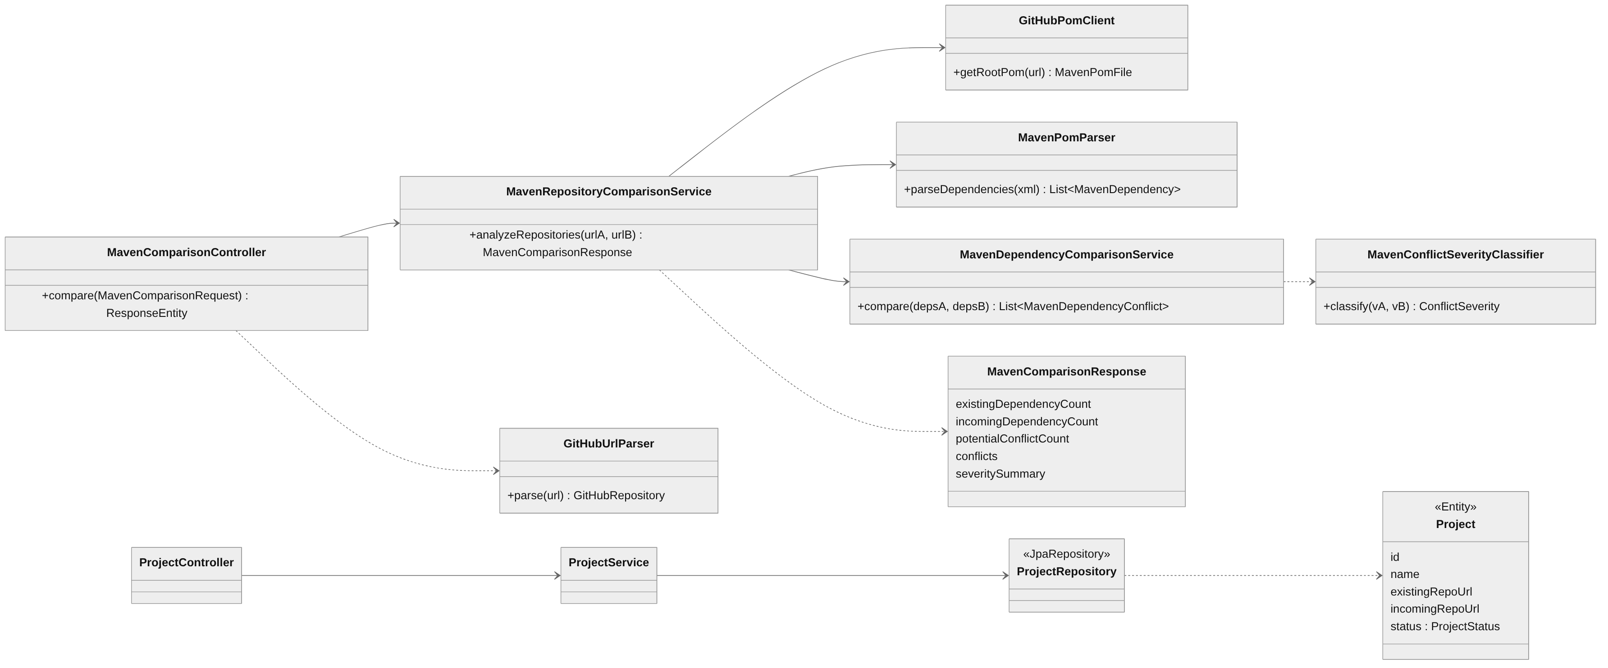
Design Document – Class Diagram
Notes:
[0:15] Design document, part 2. The comparison path is a pipeline of single-purpose classes; the project path is the classic controller → service → JPA repository → entity. Each arrow is a constructor-injected dependency, which is what makes the classes testable with mocks.

Slide 12
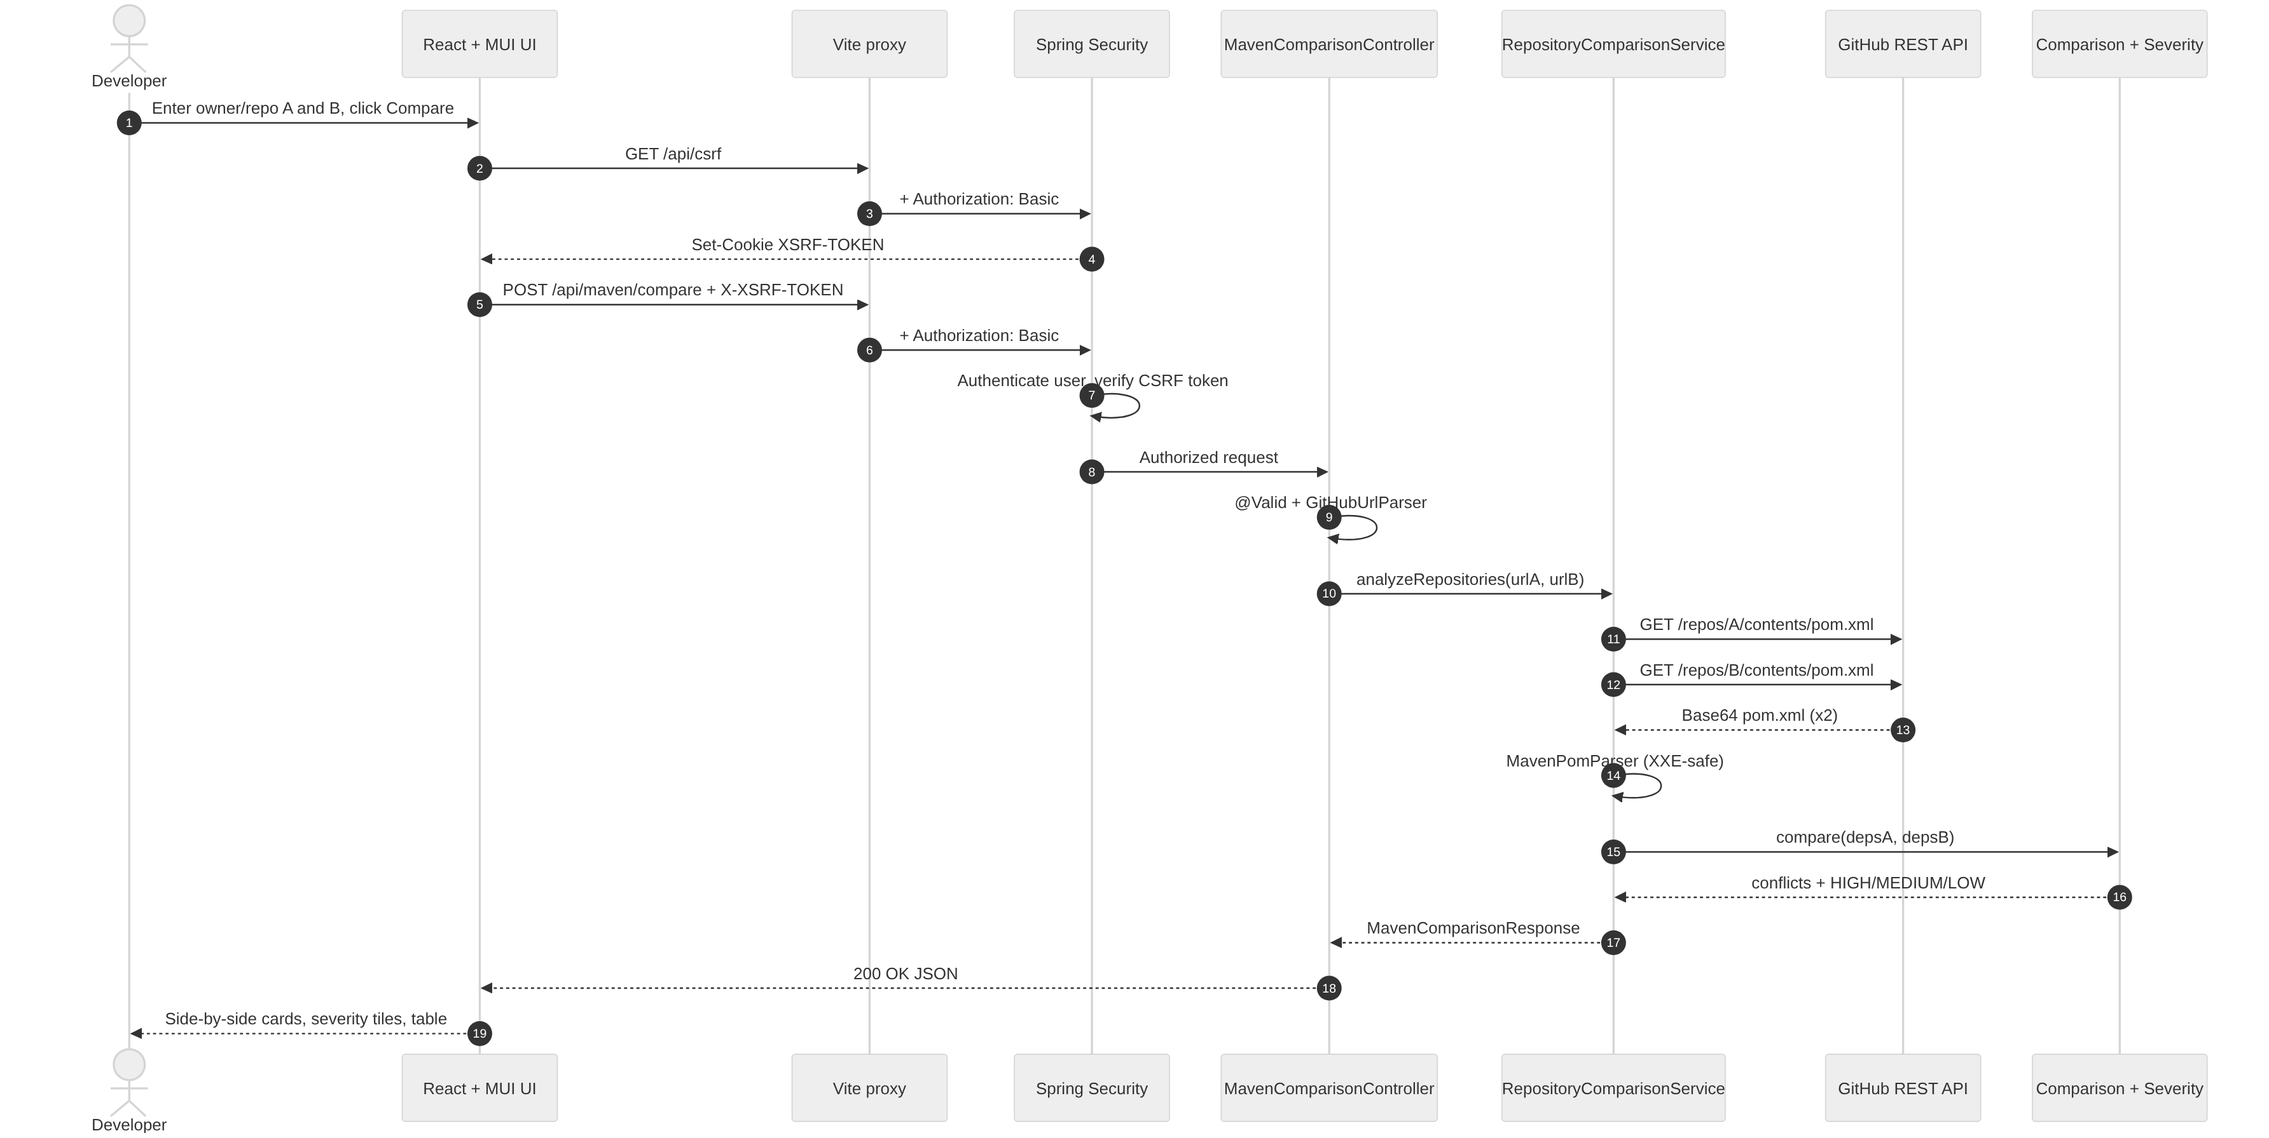
Behavior Model – Sequence Diagram: Compare Repositories
Notes:
[0:25] Behavior model 1. Follow the numbers: steps 2-4 fetch the CSRF token, 5-8 are the authenticated, token-checked request, 9 validates the URLs, 11-14 fetch and safely parse both pom.xml files, 15-16 compare and rank. Note the browser never sees the password – the proxy adds it.

Slide 13
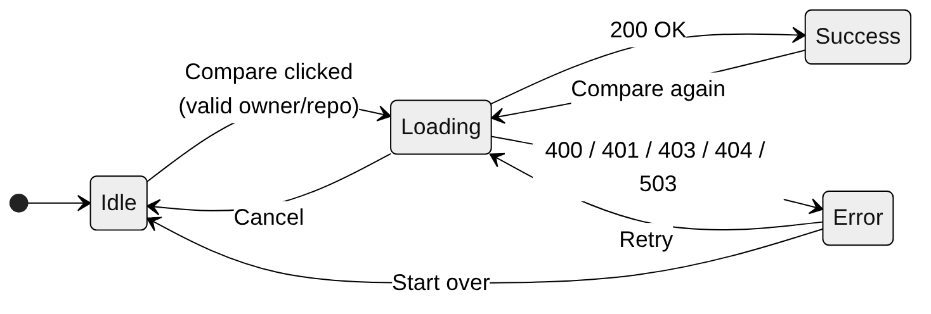
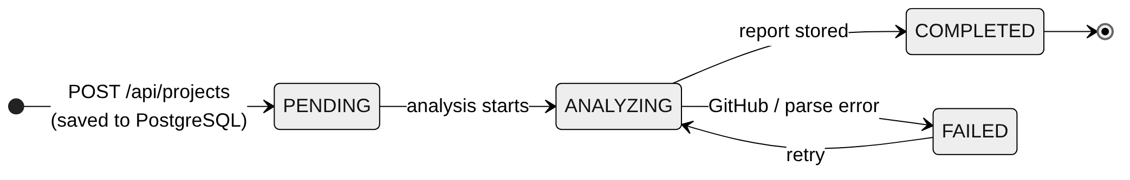
Behavior Model – State Diagrams
Comparison request (React useRepoComparison hook)
Project lifecycle (ProjectStatus enum, projects table)
Notes:
[0:15] Behavior model 2. Top: the UI comparison state machine actually implemented in the useRepoComparison hook. Bottom: the Project lifecycle defined by the ProjectStatus enum in PostgreSQL – today projects are saved as PENDING; the analysing/completed transitions arrive with the readiness report.

Slide 14
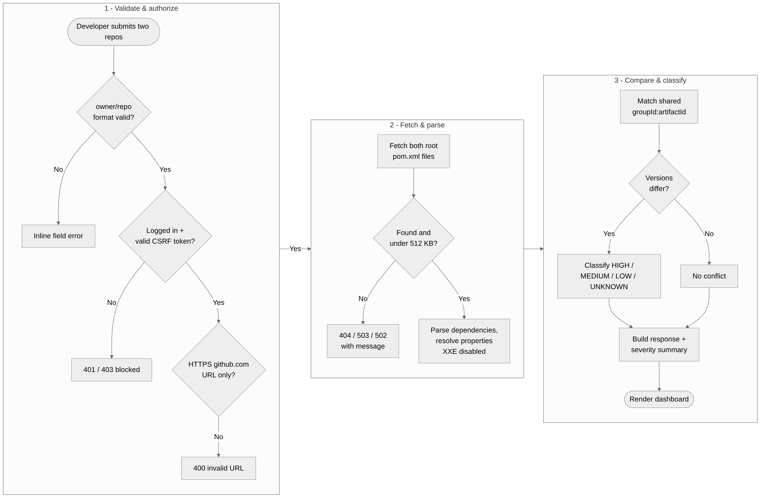
Flow Model – Activity Diagram: Compare Request
Notes:
[0:15] Flow model 1. Three stages left to right. Every diamond is a real guard in the code and maps to a real HTTP status, so the error paths in the UI are predictable.

Slide 15
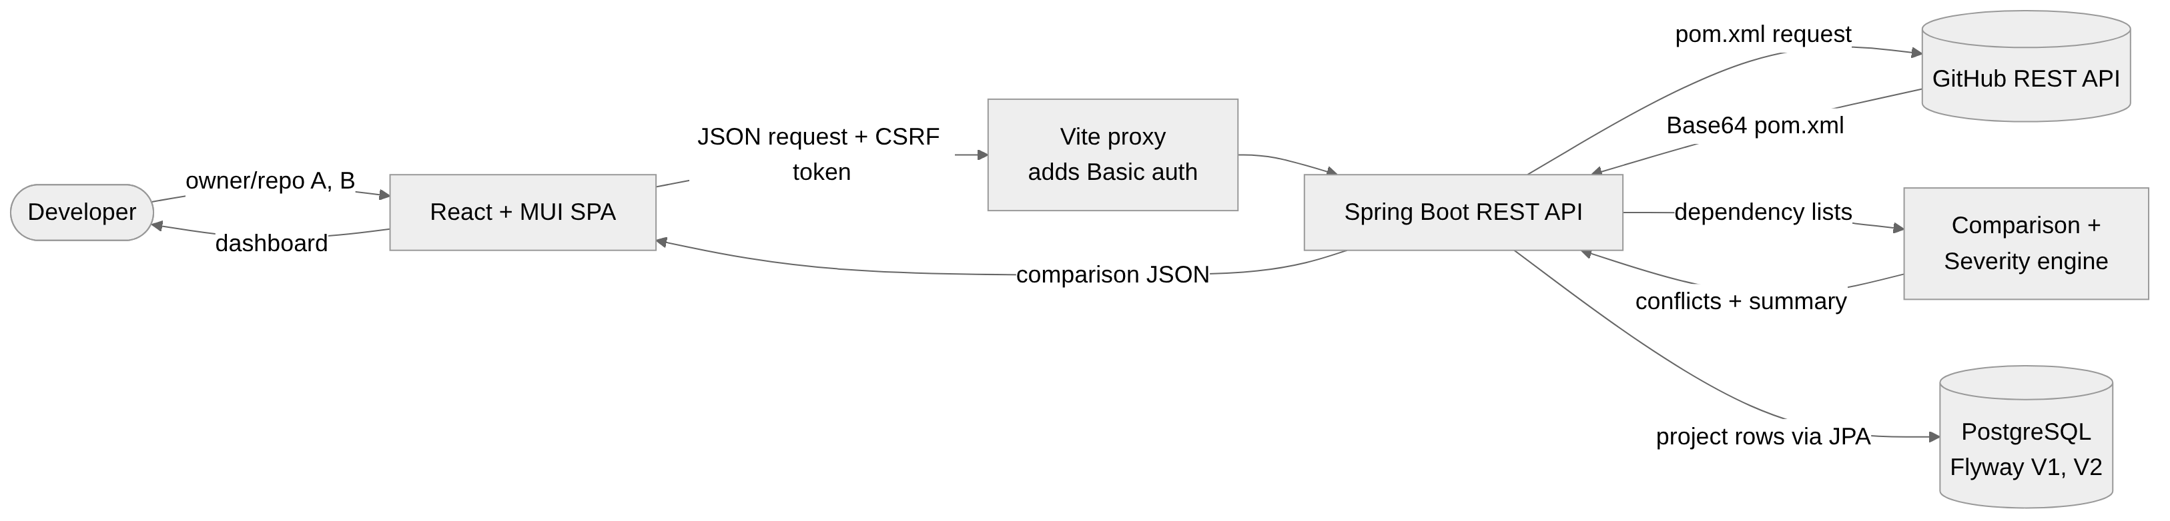
Flow Model – Data Flow Diagram
External entity
External data source
Data store
Developer – enters two repositories, reads the dashboard
GitHub REST API – Base64 pom.xml and repository metadata
PostgreSQL projects table – name, both URLs, status (Flyway V1, V2)
Notes:
[0:10] Flow model 2. What crosses each boundary: only pom.xml text comes in from GitHub, only project rows go to PostgreSQL, and credentials are added by the proxy, never stored in the browser.

Slide 16
Enterprise Security & PostgreSQL
1 Authentication
2 CSRF token
3 PostgreSQL
4 Input hardening
Spring Security filter chain
HTTP Basic on every /api/** route
Only /api/health is public
No session secrets in the browser
CookieCsrfTokenRepository → XSRF-TOKEN cookie
Client echoes it as X-XSRF-TOKEN
Missing / wrong token → 403
Verified by 6 MockMvc security tests
codebridge_db / codebridge_user
Password from DB_PASSWORD env var
Flyway V1, V2 migrations; ddl-auto=validate
CI workflow uses a Postgres 16 service
GitHub URL allow-list (HTTPS, no ports, paths, user-info)
XML parser blocks DOCTYPE / XXE
512 KB pom, 1 MB response caps; no redirects
Errors hide internal details
Enterprise next step: replace Basic auth with OAuth2 / OpenID Connect and short-lived JWT bearer tokens (Spring Resource Server), add role-based access, and load secrets from a vault instead of environment variables.
Notes:
[0:30] Be precise here: the backend uses HTTP Basic authentication plus a CSRF token – Spring stores the token in the XSRF-TOKEN cookie and rejects any POST that doesn't echo it in the X-XSRF-TOKEN header. That is token-based protection against cross-site request forgery; it is not a JWT login token. JWT/OAuth2 bearer tokens are the planned next step. PostgreSQL credentials never appear in code – the password comes from the DB_PASSWORD environment variable – and the schema is created only by versioned Flyway scripts, with Hibernate set to validate.

Slide 17
Acceptance Tests – Overview
114
17
7
114 / 114
automated tests
test classes
stories with tests
last run
Story | Acceptance criterion (Given / When / Then) | Test class | Tests
US1 | Given a non-HTTPS, non-github.com or extra-path URL, when submitted, then it is rejected and nothing is saved | GitHubUrlParserTest, ProjectControllerTest | 18
US3 | Given a pom.xml with a DOCTYPE / external entity, when parsed, then parsing is refused (XXE) | MavenPomParserTest, GitHubPomClientTest | 18
US4 | Given two dependency lists, when a shared artifact has different versions, then exactly that conflict is reported | MavenDependencyComparisonServiceTest, MavenRepositoryComparisonServiceTest, MavenComparisonControllerTest | 24
US5 | Given 1.7.36 vs 2.0.17, when classified, then severity is HIGH (minor → MEDIUM, patch → LOW) | MavenConflictSeverityClassifierTest, MavenSeveritySummaryTest | 28
US6 | Given a logged-in user without a CSRF token, when POSTing /api/maven/compare, then 403 and the service is never called | MavenComparisonSecurityTest | 10
US7 | Given a valid project, when created, then it is saved via the JPA repository and retrievable by id | ProjectServiceTest, BackendApplicationTests | 5
Notes:
[0:25] Requirement 4. 114 automated tests; result from the last run: 114 tests, 0 failures, 0 errors, 0 skipped (mvnw test, H2 dev profile, 8 Nov 2026 10:19 PM). Acceptance criteria were written as Given/When/Then and each one is an executable JUnit test – unit tests for logic, MockMvc tests for the API and security layer.

Slide 18
Acceptance Tests – Story Details (1/2)
US1
Import & validate repository pair
US3
Read pom.xml securely
US4
Detect dependency conflicts
18 automated tests · all passing
18 automated tests · all passing
24 automated tests · all passing
✓ Valid https://github.com/owner/repo is accepted
shouldParseValidGitHubUrl
✓ http://, other hosts, sub-domains are rejected
shouldRejectHttpUrl
shouldRejectNonGitHubDomain
✓ Extra paths, ports, query, user-info rejected
shouldRejectAdditionalPath
shouldRejectCustomPort
✓ Invalid project is never saved
shouldRejectInvalidGitHubDomainWithoutSaving
✓ Dependencies extracted with default scope
shouldExtractDependencies
shouldDefaultToCompileScope
✓ ${property} versions resolved, nested too
shouldResolveDependencyVersionProperty
✓ XXE / DOCTYPE payload refused
shouldRejectXXEAttack
✓ Oversized pom or response refused
shouldRejectOversizedXml
shouldRejectOversizedResponse
✓ Different versions of a shared artifact flagged
shouldDetectDifferentVersions
✓ Matching versions and non-shared deps ignored
shouldIgnoreMatchingVersions
shouldIgnoreDependenciesNotShared
✓ Unresolved ${…} versions skipped, not guessed
shouldSkipUnresolvedProperties
✓ API returns conflicts with counts
shouldReturnDependencyConflictsWithSeverity
Notes:
[0:10] Detail for the grader; don't read it. Point at one row per story: the criterion on the left is literally the name of the JUnit test on the right.

Slide 19
Acceptance Tests – Story Details (2/2)
US5
Rank conflicts by severity
US6
Authenticated, CSRF-protected API
US7
Persist projects in PostgreSQL
28 automated tests · all passing
10 automated tests · all passing
5 automated tests · all passing
✓ Major difference → HIGH
shouldClassifyMajorVersionDifferenceAsHigh
✓ Minor → MEDIUM, patch → LOW
shouldClassifyMinor…AsMedium
…PatchVersionDifferenceAsLow
✓ Non-numeric / 2-part versions → UNKNOWN
shouldClassifyNonstandardVersionsAsUnknown
✓ Summary always recomputed from conflicts
shouldIgnoreSuppliedSeveritySummaryAndRecalculate
✓ No login → 401, service not called
shouldRejectUnauthenticatedPost
✓ Login but no CSRF token → 403
shouldRejectAuthenticatedPostWithoutCsrf
✓ Login + invalid token → 403
shouldRejectAuthenticatedPostWithInvalidCsrf
✓ Login + valid token → 200 with JSON
shouldAcceptAuthenticatedPostWithValidCsrf
✓ Project saved through JPA repository
shouldCreateProject
✓ All projects listed
shouldGetAllProjects
✓ Lookup by id; unknown id → empty / 404
shouldGetProjectById
shouldReturnEmptyForUnknownProject
✓ Context + Flyway schema load (CI: Postgres 16)
contextLoads
Notes:
[0:10] Detail for the grader; don't read it. Point at one row per story: the criterion on the left is literally the name of the JUnit test on the right.

Slide 20
Code – US1 Import & Validate Repositories
dto/MavenComparisonRequest.java · github/GitHubUrlParser.java
US1
Import & validate repository pair
9► @Pattern(regexp = "^https://github\\.com/[A-Za-z0-9_.-]+"
10► + "/[A-Za-z0-9_.-]+/?$")
13 String existingRepositoryUrl,
…
24 URI uri = new URI(url);
26► if (!"https".equalsIgnoreCase(uri.getScheme())
27► || !"github.com".equalsIgnoreCase(uri.getHost())
28► || uri.getUserInfo() != null
29► || uri.getPort() != -1
30► || uri.getQuery() != null
31 || uri.getFragment() != null) {
33 throw new IllegalArgumentException(
34 "Only HTTPS GitHub repository URLs are supported");
36 }
…
48► if (parts.length < 3 || parts.length > 4 ...) {
53 throw new IllegalArgumentException(
54 "Expected https://github.com/owner/repository");
56 }
61► if (!OWNER_PATTERN.matcher(owner).matches()
64► || !REPOSITORY_PATTERN.matcher(repository).matches()
65 || repository.equals(".") || repository.equals("..")) {
68 throw new IllegalArgumentException("Invalid owner or repo");
71 }
73 return new GitHubRepository(owner, repository);
Highlighted lines satisfy:
✓ Only https://github.com/owner/repo is accepted
✓ Ports, user-info, query strings and extra paths rejected (blocks SSRF tricks)
✓ Invalid input never reaches GitHub or the database
Proven by
GitHubUrlParserTest (12)
ProjectControllerTest (4)
ProjectRequestTest (2)
Notes:
[0:10] Two layers: Bean Validation on the request DTO, then a strict URI parser. Highlighted lines are the allow-list – this is what stops someone pointing the server at an internal host.

Slide 21
Code – US3 Read pom.xml Securely
maven/MavenPomParser.java
US3
Secure pom.xml parsing
33 public List<MavenDependency> parseDependencies(String xml) {
41► if (xml.getBytes(UTF_8).length > MAX_XML_BYTES) {
42 throw new IllegalArgumentException(
43 "Maven pom.xml exceeds the allowed size");
45 }
48 DocumentBuilderFactory factory =
49 DocumentBuilderFactory.newDefaultInstance();
52► factory.setXIncludeAware(false);
53► factory.setExpandEntityReferences(false);
55 factory.setFeature(
56► XMLConstants.FEATURE_SECURE_PROCESSING, true);
60 factory.setFeature(
61► "http://apache.org/xml/features/disallow-doctype-decl",
62► true);
65► factory.setAttribute(XMLConstants.ACCESS_EXTERNAL_DTD, "");
70► factory.setAttribute(XMLConstants.ACCESS_EXTERNAL_SCHEMA, "");
75 DocumentBuilder builder = factory.newDocumentBuilder();
77 Document document = builder.parse(
78 new InputSource(new StringReader(xml)));
…
// then: read <dependencies>, skip <dependencyManagement>,
// resolve ${property} versions (max 10 passes)
Highlighted lines satisfy:
✓ pom.xml larger than 512 KB is refused
✓ DOCTYPE / external entities disabled – XXE attack fails
✓ Properties like ${junit.version} are resolved before comparing
Proven by
MavenPomParserTest (13)
GitHubPomClientTest (5)
Notes:
[0:10] We parse XML downloaded from the internet, so the parser is locked down: no DOCTYPE, no external DTD or schema, no entity expansion. The XXE test feeds it a file:///etc/passwd entity and expects a refusal.

Slide 22
Code – US4 Detect Dependency Conflicts
maven/MavenDependencyComparisonService.java
US4
Detect version conflicts
14 public List<MavenDependencyConflict> compare(
15 List<MavenDependency> existingDependencies,
16 List<MavenDependency> incomingDependencies) {
…
28 Map<String, MavenDependency> existingMap = new HashMap<>();
31 for (MavenDependency dependency : existingDependencies) {
33► String key = dependency.groupId() + ":"
35► + dependency.artifactId();
37 existingMap.put(key, dependency);
38 }
43 for (MavenDependency incoming : incomingDependencies) {
49► MavenDependency existing = existingMap.get(key);
51 if (existing == null) continue; // not shared
59 if (existingVersion == null || incomingVersion == null)
60 continue; // unknown version
64► if (existingVersion.contains("${")
65► || incomingVersion.contains("${")) continue;
69► if (!existingVersion.equals(incomingVersion)) {
71► conflicts.add(new MavenDependencyConflict(
72 incoming.groupId(), incoming.artifactId(),
74 existingVersion, incomingVersion));
77 }
78 }
80 return List.copyOf(conflicts);
Highlighted lines satisfy:
✓ Shared groupId:artifactId with different versions is reported
✓ Matching or non-shared dependencies are ignored
✓ Unresolved ${…} versions are skipped, never guessed
Proven by
MavenDependencyComparisonServiceTest (7)
MavenRepositoryComparisonServiceTest (9)
MavenComparisonControllerTest (8)
Notes:
[0:10] O(n) comparison: index repo A by groupId:artifactId, then walk repo B. The highlighted guards are why the results are trustworthy – we only report what we can actually prove differs.

Slide 23
Code – US5 Rank Conflicts by Severity
maven/MavenConflictSeverityClassifier.java
US5
Severity ranking
12► private static final Pattern VERSION_PATTERN =
13► Pattern.compile("^(\\d+)\\.(\\d+)\\.(\\d+)$");
…
15 public ConflictSeverity classify(String existingVersion,
17 String incomingVersion) {
19 if (existingVersion == null || incomingVersion == null)
20 return ConflictSeverity.UNKNOWN;
29 // Do not guess when version formats are unfamiliar.
30► if (!existingMatcher.matches() || !incomingMatcher.matches())
31► return ConflictSeverity.UNKNOWN;
…
49► if (existingMajor != incomingMajor) {
50► return ConflictSeverity.HIGH; // 1.7.36 vs 2.0.17
51 }
53► if (existingMinor != incomingMinor) {
54► return ConflictSeverity.MEDIUM; // 2.0.0 vs 2.1.0
55 }
57► if (existingPatch != incomingPatch) {
58► return ConflictSeverity.LOW; // 1.4.4 vs 1.4.5
59 }
63 return ConflictSeverity.UNKNOWN;
65 } catch (NumberFormatException e) { // huge numbers
67 return ConflictSeverity.UNKNOWN;
Highlighted lines satisfy:
✓ Major difference → HIGH, minor → MEDIUM, patch → LOW
✓ Non-semantic versions → UNKNOWN (no guessing)
✓ Severity summary always recomputed from the conflict list
Proven by
MavenConflictSeverityClassifierTest (11)
MavenSeveritySummaryTest (7)
MavenComparisonResponseTest (8)
MavenDependencyConflictJsonTest (2)
Notes:
[0:10] Severity is semantic-version distance, not a vulnerability score – say that explicitly, graders like the honesty. The demo pair joda-time vs JSON-java hits the HIGH branch: junit 3.8.2 vs 4.13.2.

Slide 24
Code – US6 & US7 Security Token and PostgreSQL
config/SecurityConfig.java · application.properties · V1 migration
US6
Security + PostgreSQL (US6, US7)
19 return http.authorizeHttpRequests(auth -> auth
28 .requestMatchers("/api/health").permitAll()
31► .anyRequest().authenticated())
33► .httpBasic(basic -> {})
34► .csrf(csrf -> csrf
35► .csrfTokenRepository(
36► CookieCsrfTokenRepository.withHttpOnlyFalse())
38 .csrfTokenRequestHandler(new SpaCsrfTokenRequestHandler()))
42 .build();
# ---- application.properties (default profile) ----
4► spring.datasource.url=jdbc:postgresql://localhost:5432/codebridge_db
5 spring.datasource.username=codebridge_user
6► spring.datasource.password=${DB_PASSWORD}
9► spring.jpa.hibernate.ddl-auto=validate
-- ---- db/migration/V1__create_projects_table.sql ----
1 CREATE TABLE projects (
2 id BIGINT GENERATED BY DEFAULT AS IDENTITY PRIMARY KEY,
3 name VARCHAR(255) NOT NULL,
4 existing_repo_url VARCHAR(255) NOT NULL,
5 incoming_repo_url VARCHAR(255) NOT NULL);
-- V2 adds: status VARCHAR(20) NOT NULL DEFAULT 'PENDING'
Highlighted lines satisfy:
✓ Every API call except health needs a login
✓ POSTs without a valid XSRF-TOKEN echo get 403
✓ DB password injected from the environment, never in code
✓ Schema only changes through versioned Flyway scripts
Proven by
MavenComparisonSecurityTest (6)
GlobalExceptionHandlerTest (4)
ProjectServiceTest (4)
BackendApplicationTests (1)
Notes:
[0:12] This is the 'enterprise' slide in code. Top: authentication plus the CSRF token store. Middle: PostgreSQL with the password from DB_PASSWORD and Hibernate in validate mode, so the app refuses to start if code and schema drift. Bottom: the Flyway migration that owns the schema.

Slide 25
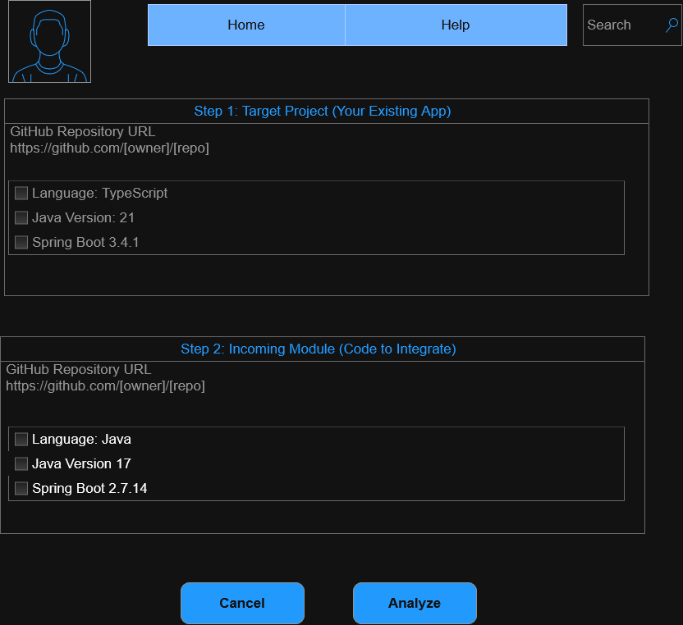
Live Demo
Demo script (45 seconds)
Verified repository pairs
1
Header shows Backend online (GET /api/health)
HIGH
JodaOrg/joda-time
vs stleary/JSON-java
junit 3.8.2 → 4.13.2
2
Enter JodaOrg/joda-time and stleary/JSON-java
3
Compare → spinner while both pom.xml files load
MEDIUM
stleary/JSON-java
vs square/javapoet
mockito-core 4.2.0 → 4.11.0
4
Side-by-side cards: dependencies, language, branch
LOW
square/javapoet
vs google/compile-testing
truth 1.4.4 → 1.4.5
5
HIGH tile: junit 3.8.2 → 4.13.2 (major jump)
6
Toggle dark mode; resize to show the phone layout
Backup if Wi-Fi fails: npm run dev:mock (no GitHub calls)
Notes:
[0:35] Have backend + frontend already running and the browser on localhost:5173 before you start. GitHub allows ~60 unauthenticated calls/hour – don't rehearse right before presenting. If the network fails, switch to npm run dev:mock or show a 30-second screen recording.

Slide 26
Conclusion & Next Steps
Delivered: separate React + MUI frontend and Spring Boot backend, secured with HTTP Basic + CSRF tokens.
Delivered: GitHub pom.xml retrieval, XXE-safe parsing, dependency-conflict detection and HIGH / MEDIUM / LOW ranking.
Quality: 114 automated tests across 7 implemented user stories; PostgreSQL schema under Flyway version control.
Next: OAuth2 / JWT bearer tokens and roles, Java & Spring Boot version checks, parent-POM (BOM) resolution.
Next: integration-readiness report with risk score and the RAG assistant from the original vision.
Notes:
[0:20] Close on the value: a developer gets an evidence-based risk list in seconds instead of reading two pom.xml files by hand. Then one sentence on Phase 3.

Slide 27
Any Questions / Comments ?
Notes:
Likely questions: why Basic instead of JWT (scope – next step), why only the root pom.xml, how severity is defined.

Slide 28
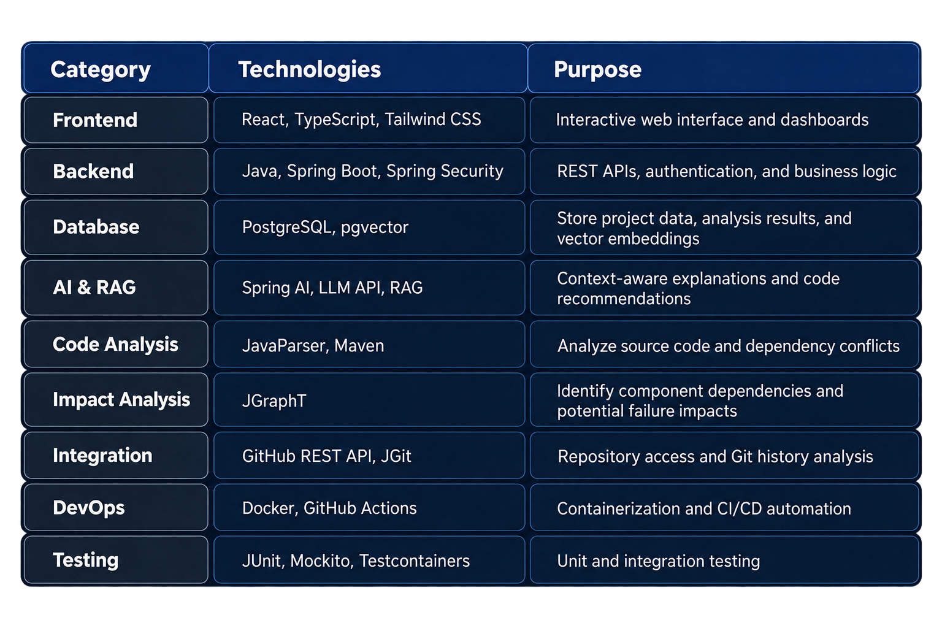
Appendix – Tech Stack
Layer | Technology | Used for
Frontend | React 19, TypeScript, Vite 7, MUI 7, Axios | Single-page dashboard, CSRF-aware API client
Backend | Java 21, Spring Boot 4, Spring Web MVC, Validation | REST API, request validation, error handling
Security | Spring Security (HTTP Basic, CookieCsrfTokenRepository) | Authentication + CSRF token on every state change
Database | PostgreSQL 16, Spring Data JPA, Flyway (H2 for local dev) | Project storage, versioned schema migrations
Integration | GitHub REST API (contents + repos endpoints) | Fetch pom.xml files and repository metadata
Testing | JUnit 5, Mockito, MockMvc, spring-security-test | 114 automated unit and API tests
DevOps & docs | GitHub Actions (Postgres 16 service), springdoc OpenAPI / Swagger UI | CI on every push, live API docs
Notes:
Backup slide – show only if asked about technology choices.

Slide 29
Appendix – Background
Modern software development increasingly relies on reusing open-source code and integrating existing GitHub repositories to accelerate development. However, differences in dependencies, framework versions, configurations, and software architecture often create compatibility challenges.
Motivation
Manual Analysis: Understanding unfamiliar repositories and identifying conflicts is time-consuming.
Integration Risks: Dependency mismatches and incompatible code can cause unexpected failures.
Lack of Early Detection: Integration issues are often discovered during implementation or testing.
Need for Intelligent Assistance: Developers require automated risk assessment and context-aware code recommendations.
Notes:
Backup slide – background and motivation from Phase 1.

